Slide 1
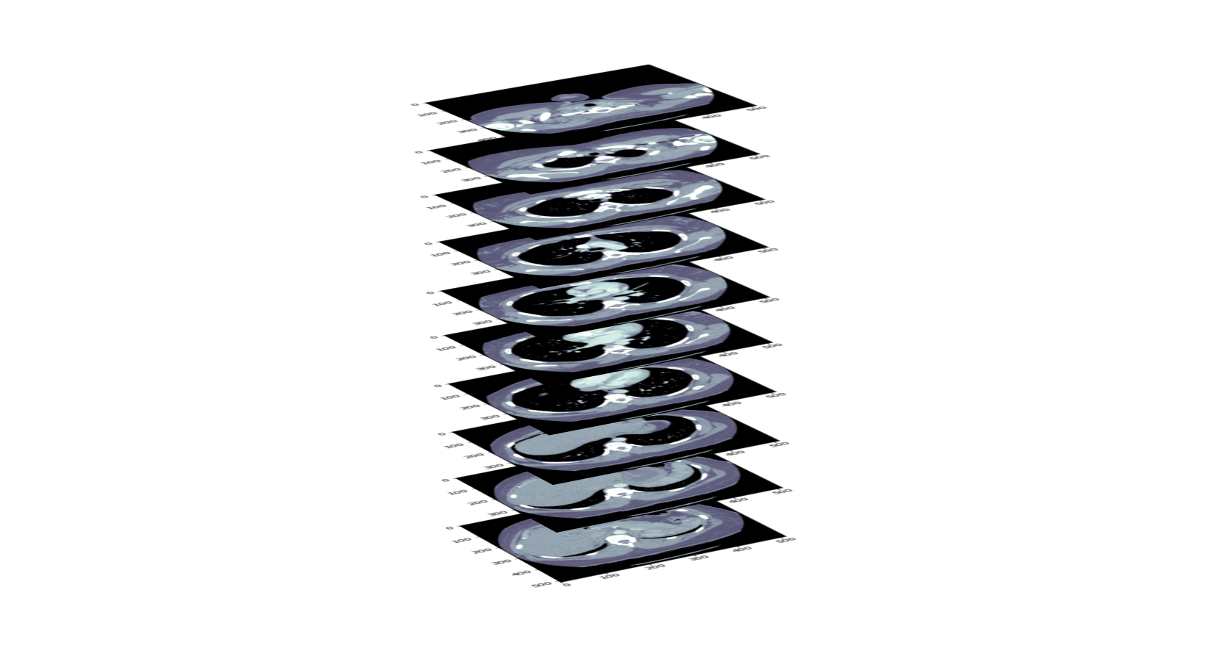
RSNA STR Pulmonary Embolism Detection 7th Place Yuval Reina
Notes:
Recommending picking out he most interesting and important parts from your documentation.

Slide 2
Agenda
Background
Summary
Base Models
Transformer Models
2nd Opinion Ensembling
Next step

Slide 3
Background
Yuval Reina
BScEE, MBA, VP R&D @ D-Fend
Hobbyist, Self-Education

Slide 4
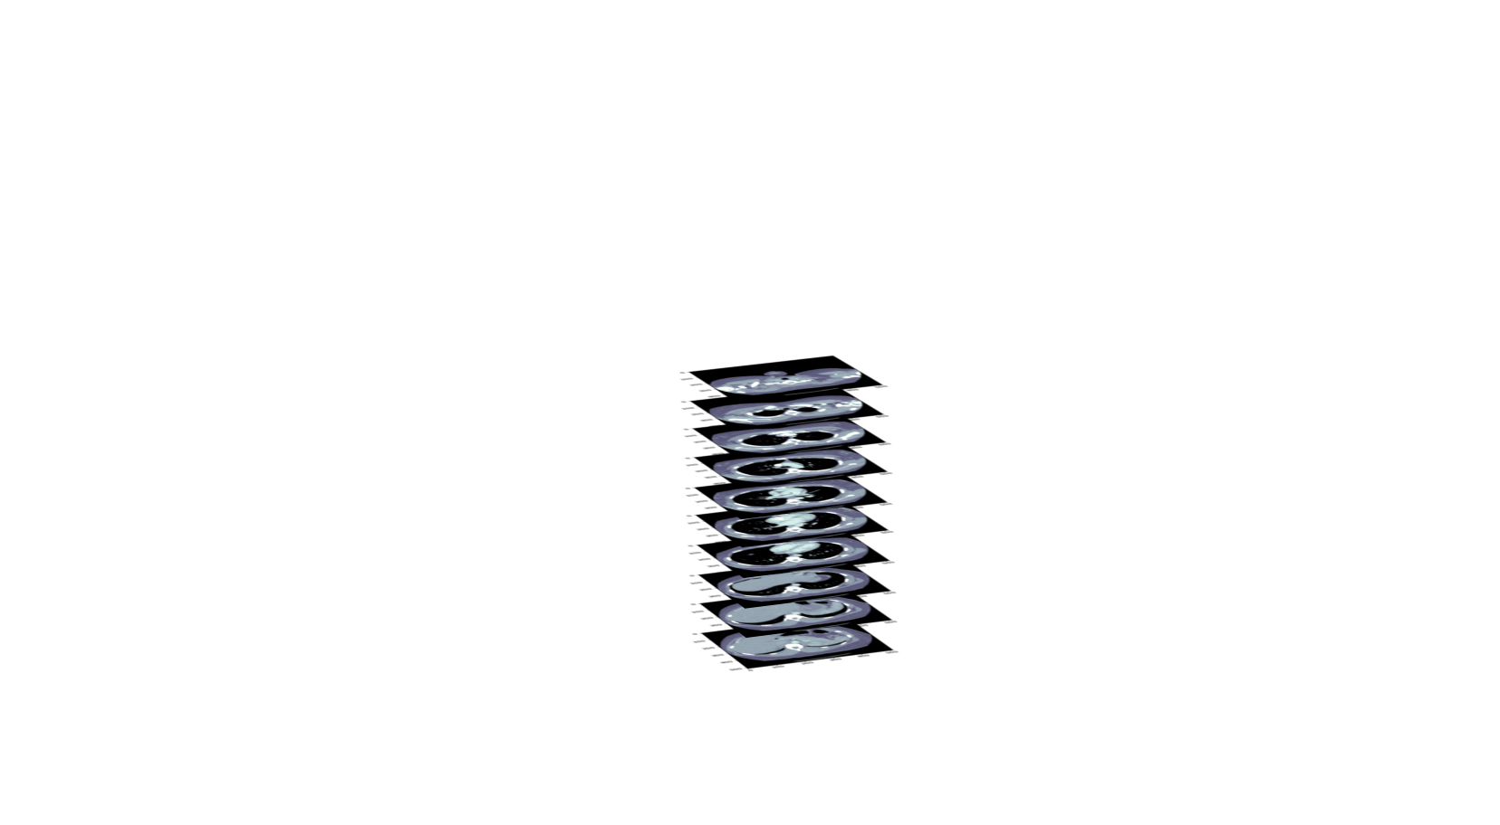
Two stage solution:
Base model for feature extraction per image
Transformer model for context learning
Summary
N * PE in image
Base
Network
No
Classifier
Transformer Network
N Feature Vectors
Series classes
N Images
Positional
Encoding

Slide 5
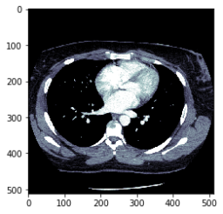
Two stage solution:
Base model for feature extraction per image
Summary
WSO
EfficientNet
Linear/poolong Layer
Classifier
Predictions
Features
Base Network
Pre – trained models:
EfficientNet B3, B5

Slide 6
Two stage solution:
Transformer model for context learning
Summary
N Feature Vectors
Self Attention
Feed forward Network
Self Attention
Feed forward Network
Self Attention
Feed forward Network
Self Attention
Feed forward Network
Encoder Layer
* 4 Layers
N * C
Output matrix
C ->1 Linear
N * ‘PE present on image’
C -> 9 Linear
9 series classes

Slide 7
Base Models
As base model I used different types of EfficientNet
B3, B5
Pre-trained on Imagenet using Noisy student algorithm
Loss Functions:
Weighted BCE on ‘PE present on image’ and the series classes
If ‘PE present on image’ =0 then all series classes are set to 0, except the QA classes
Number of Features – 256

Slide 8
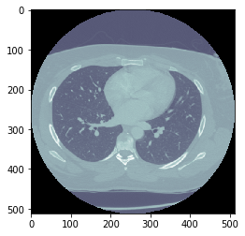
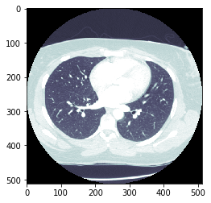
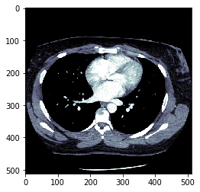
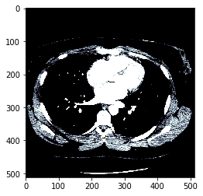
The dynamic range of the CT pixel values is very large. One way to handle this is with windowing as seen below.
In our model we used adaptive windowing:
P_{new}= sigmoid(a*P_{orig}+b)
a, b are optimized by the network
This is easily achieved by using a 2D conv with 1*1 kernel.
WSO - Windowing
This idea was introduced In: Hyunkwang Lee, Myeongchan Kim, Synho Do, Practical Window Setting Optimization for Medical Image Deep Learning, https://arxiv.org/pdf/1812.00572.pdf

Slide 9
Augmentation
Random resize + crop
Random rotation
Random flip
Random shift of CT’s of mean and std
Cutout - erasing a small rectangle in the image
Training
Use sampler to emphasize the positive targets and slices near the center
Epoch size = 0.15*training data
Feature extraction
The feature where extracted by the output of the last layer before the classification layer.
Base Models –
Cont.

Slide 10
The transformer is a stack of 4 - 6 transformer encoder as described in Attention Is All You Need with 2 - 4 attention heads
The input is N feature vectors from the same series.
N = 128, if the patient has more then 127 images, they are randomly grouped to groups of equal size and padded to 128.
Slice order and relative position is embedded and added to the feature vectors
Transformer Model

Slide 11
The output of the plain transformer is N * C matrix
To get the models output I use 2 extra linear layers:
C -> 1 layer to get N * ‘PE present on Image’
C -> 9 layer to get 9 series classes (Run only on the N’th output vector)
Transformer Model - Output

Slide 12
Transformer Training
Augmentation
Add noise to the feature vectors
Different random grouping every epoch
Loss Functions:
Mimics the competition’s metric

Slide 13
Inference
Use the base model to extract features for each CT with no augmentation
Randomly Divide the slices of the series to equal size groups, up to 127 and pad to 128
Inference using Transformer network.
TTA – repeat steps 2-3 12 times and average the results

Slide 14
Training And Inference Times
Setup:
CPU – Intel i9-9920
RAM – 64G
GPU – Tesla V100 32G / Titan RTX (20% slower)
Training:
Base Models: ~ 9 (B5) h/model
Feature extraction: 3 – h/model
Transformer: 15min/model
Total time for all models (4) ~ 48H for 1 GPU
Inference:
Inference 4H/model (Kaggle kernel)

Slide 15
Ensembling –
2nd Opition Method
Motivation : Each model’s full Inference time ~ 4H on Kaggle’s kernel => only 2 models can be ensembled in 9H
Solution: Do Ensembling only for series with the highest uncertainty in classification.
The uncertainty is high if the classification value is near 0.5
The procedure
full inference with 1st model.
use the uncertainty to select about 50% of the series and interface with a 2nd model and Ensemble
use the uncertainty to select about 50% of the series and interface with a 3rd model and Ensemble
use the uncertainty to select about 25% of the series and interface with a 4th model and Ensemble

Slide 16
Ensembling –
Models Used
The models which were used in the final solution are:
base - EfficientNet b5 noisy student, fold 0/5, transformer - 4 encoders, 2 attention heads, 2048 feedforward dim.
base - EfficientNet b5 noisy student, fold 2/5, transformer - 4 encoders, 2 attention heads, 3072 feedforward dim.
base - EfficientNet b5 noisy student, fold 1/5, transformer - 4 encoders, 4 attention heads, 3072 feedforward dim.
base - EfficientNet b3 noisy student, fold 0/5, transformer - 6 encoders, 4 attention heads, 2048 feedforward dim.

Slide 17
Private LB - 0.157
Public LB - 0.158
Results

Slide 18
Unified model for CT scans
The current model (without ensembling) is quit simple and flexible. This type of model could have scored high also in 2019 ‘RSNA Intracranial Hemorrhage Detection’
The heavy lifting in the model is the base model training
A base model can be trained on various types of CT scans (Lungs, Head, etc.)
This base model can be used without fine-tuning to extract features for various tasks related to CT scans.
The only fine-tuning will be done on the 2nd layer (transformer, or other type of layer)
Next steps

Slide 19
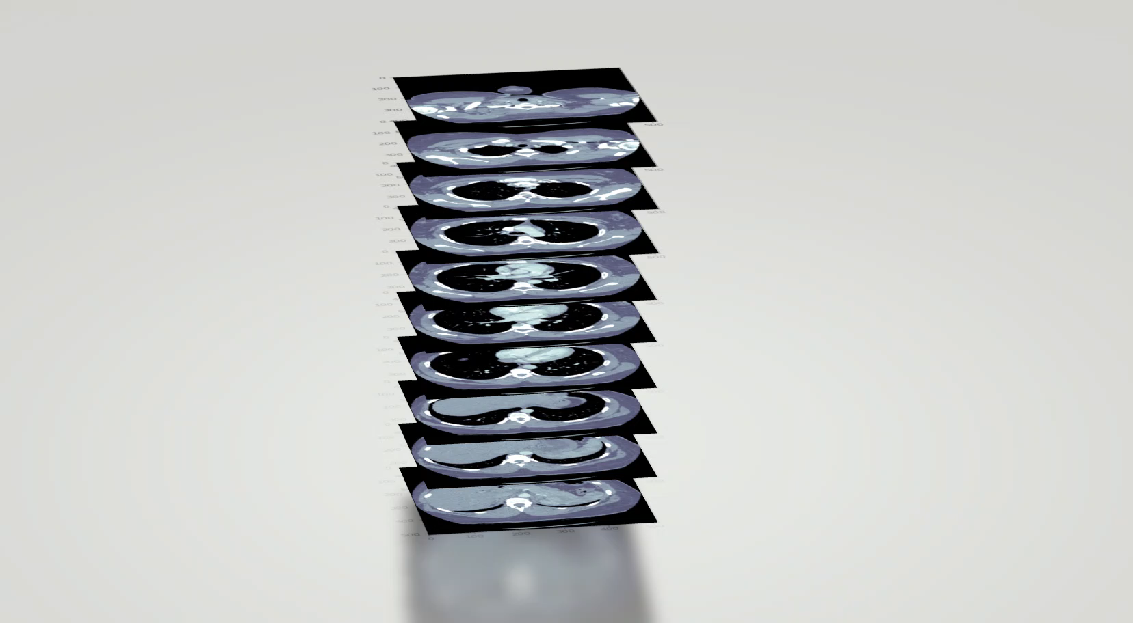

RSNA
Kaggle

